Slide 1
Machine Learning
Decision Trees Close-up
By: Faris Hassan
Farisology

Slide 2
Why Decision Trees:
No domain knowledge required
Easy to understand (Interpretability)
Learning steps are simple and fast

Slide 3
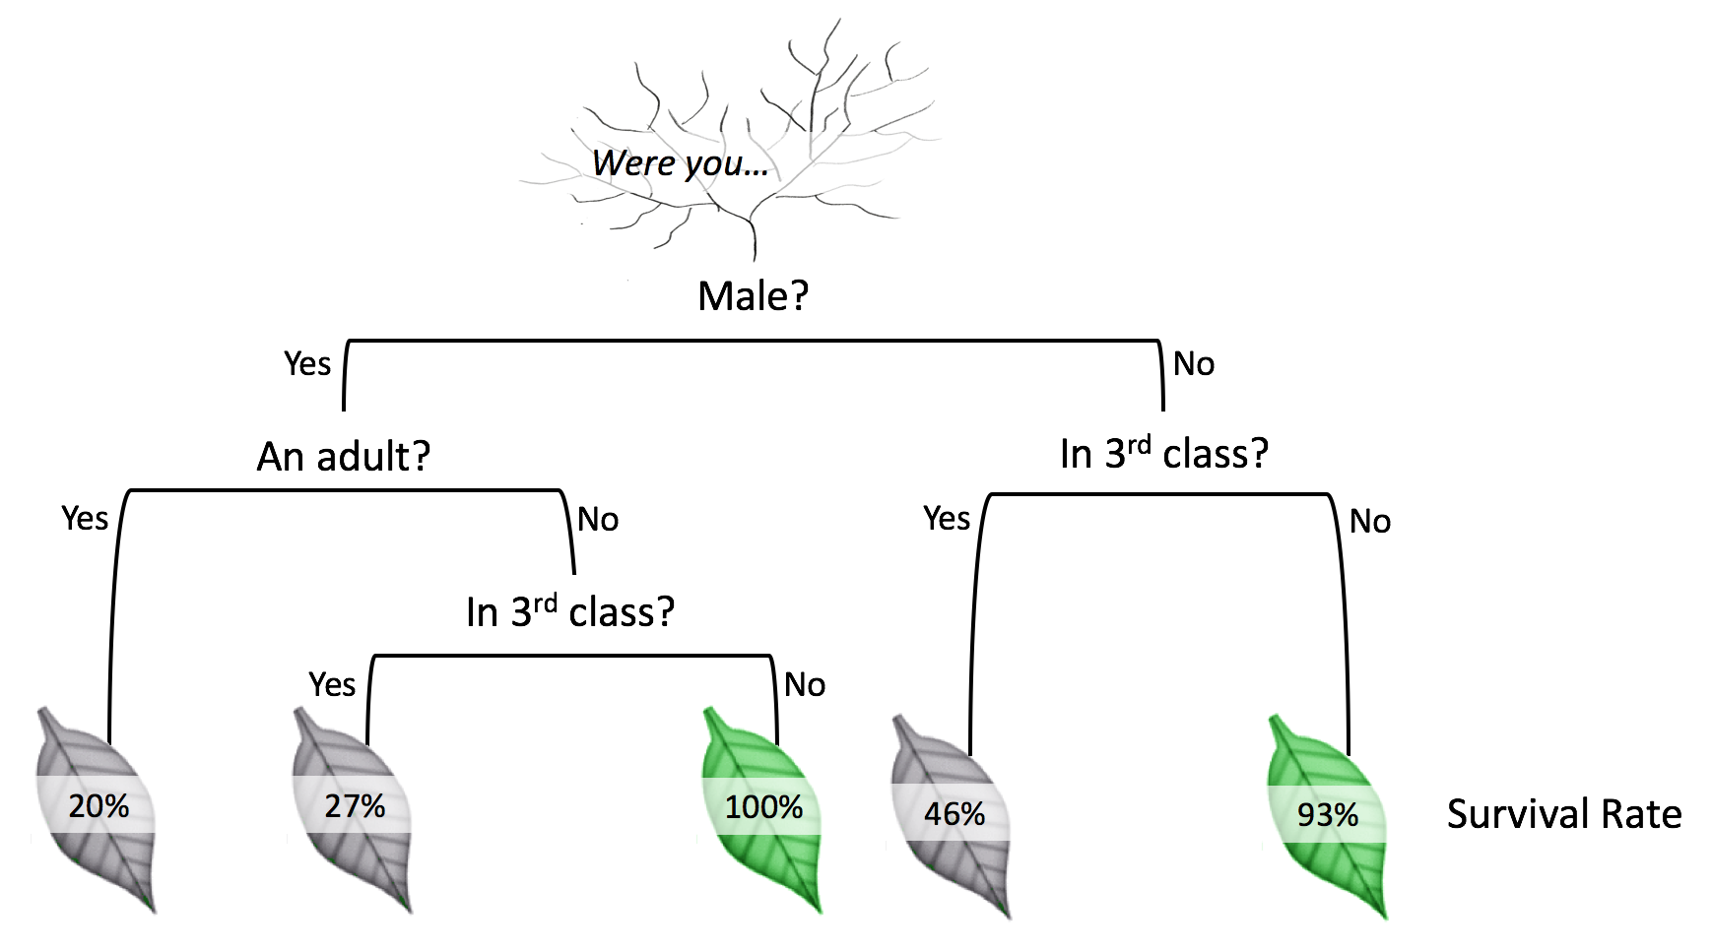
Components of Decision Tree
Root Node
Branches
Leaf Nodes

Slide 4
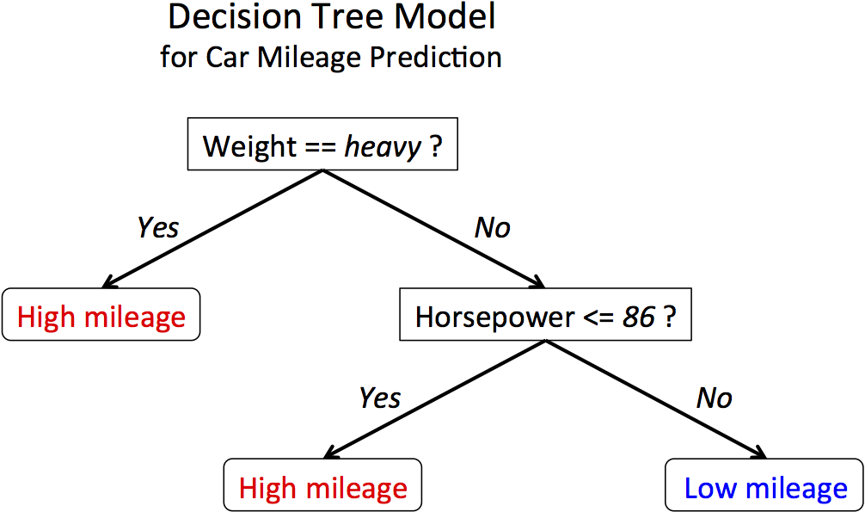
Learning Steps in a Decision Tree

Slide 5
CART Classification and Regress Trees
Classification: Usually the response variable has two classes: Yes or No (1 or 0). If the response variable has more than 2 categories, then a variant of the algorithm, called C4.5, is used. For binary splits however, the standard CART procedure is used. Thus classification trees are used when the response or target variable is categorical in nature.
Regression: needed when the response variable is numeric or continuous.

Slide 6
Day | Outlook | Humidity | Wind | Play Tennis
D1 | Sunny | High | Weak | No
D2 | Sunny | High | Strong | No
D3 | Overcast | High | Weak | Yes
D4 | Rain | High | Weak | Yes
D5 | Rain | Normal | Weak | Yes
D6 | Rain | Normal | Strong | No
D7 | Overcast | Normal | Strong | Yes
D8 | Sunny | High | Weak | No
D9 | Sunny | Normal | Weak | Yes
D10 | Rain | Normal | Weak | Yes
D11 | Sunny | Normal | Strong | Yes
D12 | Overcast | High | Strong | Yes
D13 | Overcast | Normal | Weak | Yes
D14 | Rain | High | Strong | No

Slide 7
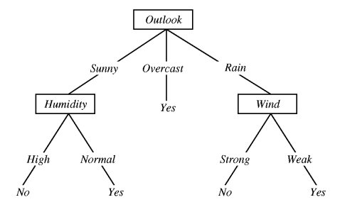
Play Tennis Tree

Slide 8
How TH you get that ?

Slide 9
How does Learning happen in DT ?

Slide 10
Entropy Theory Information Gain

Slide 11

Entropy Theory
Entropy is a measure of uncertainty in data.
$$E=−\sum_{i=1}^{m}{p_{i} \log_{2}{(p_{i})}}$$
Information Gain.
$$I={E_{\left(Before Split\right)} −E}_{\left(AfterSplit\right)}$$

Slide 12

Entropy
Pure set (4 yes/0 No)
$I=−\frac{4}{4} \log_{2}{\frac{4}{4} −\frac{0}{4} \log_{2}{\frac{0}{4}}}$ = ?
Impure set (3 yes/ 4No)
$I=−\frac{3}{7} \log_{2}{\frac{3}{7} −\frac{4}{7} \log_{2}{\frac{4}{7}}}$ = ?

Slide 13


Get into your momentum and GROW

